Slide 1

Introduction to Operating Systems CS/COE 1550
Spring 2020-2021
Sherif Khattab
ksm73@pitt.edu
(Some slides are from Silberschatz, Galvin and Gagne ©2013)

Slide 2
Announcements
Upcoming deadlines:
3/28: Lab 3, Quiz 2, and Homework 9
4/2: Project 3 (Virtual Memory Simulator)
Tophat questions due one week after each lecture

Slide 3
Last Lecture …
Address Translation
2-level Page Table
TLB

Slide 4
Muddiest Points (1/2)
TLB
Another rundown of the purpose and usage of the TLB
How TLB works
Can you go over the TLB in more detail?
what a process space identifier is in TLB entries
Pros & Cons of Hardware vs. Software TLB replacemen
Two-level paging
What is the advantage of having a multilevel page table? It seems like it would take up even more space than a single level page table unless most of the 2nd level pages were kept on disk
Why two-level page tables are an improvement over single-level page tables. Where is the optimization?
what exactly the 1st level page tables and the 2nd level page tables contain
Advantages and disadvantages of a two level page table.
How does using multi-level page tables reduce the size of the entries in the page table? Isn't overall page table entries still the same since the size of the first page table + size of the second page table would equal the size of the original 1-level page table?
Is there an optimal number of levels for multi-level page tables? How many levels are generally used?
Does using a mult-level page table significantly increase or decrease the average response time compared to using a single level table? Does that depend on the number of page table entries?
pros and cons of a bigger or smaller level 1 or 2 of the page table

Slide 5
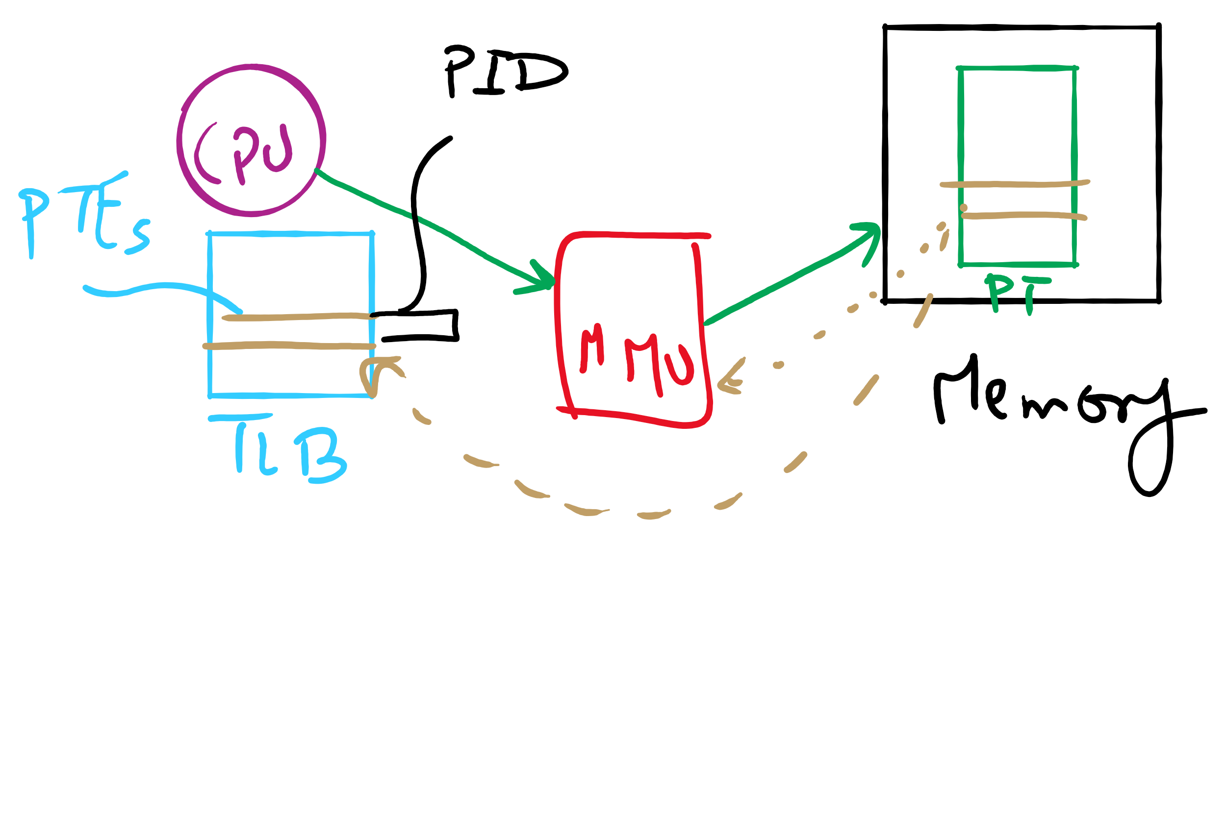
TLB

Slide 6
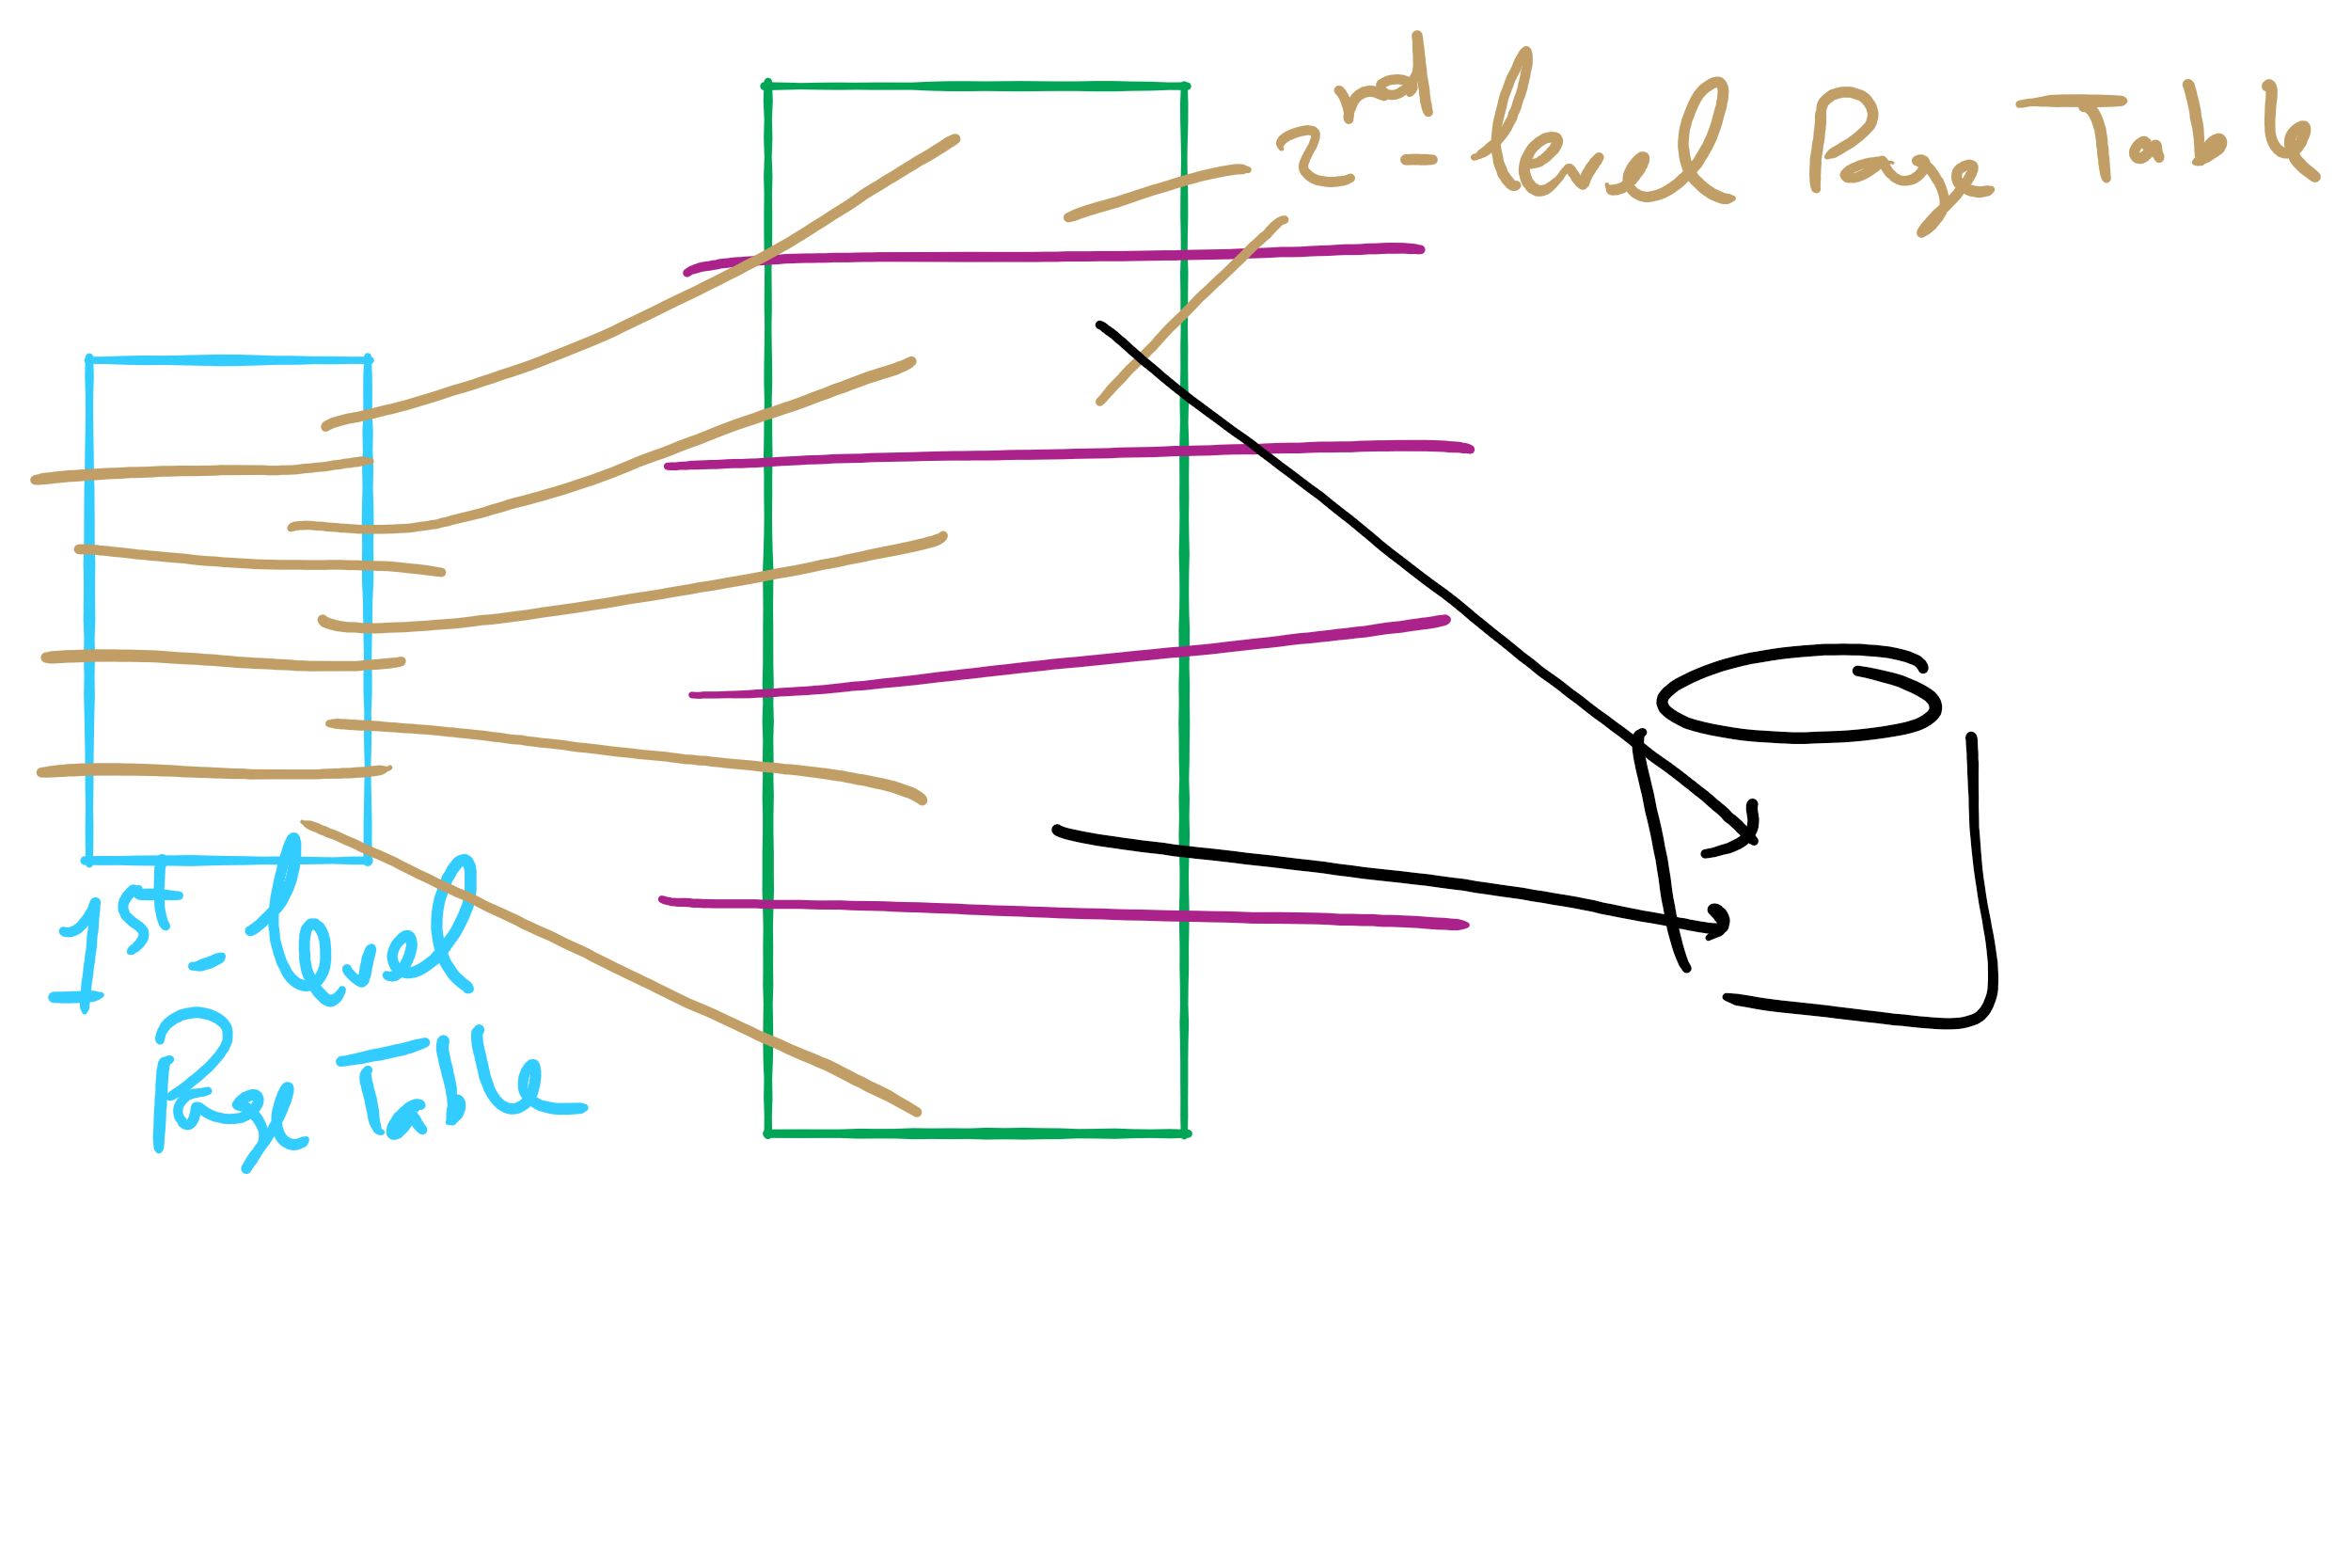
Two-level Page Table

Slide 7
Muddiest Points (2/2)
I am still confused between switching from KB or GB to bytes and where the numbers are coming from for page table size and things like that
Still a bit confused on how to calculate avg waiting time
Project 3
Could you please give a example of implementing optimal algorithm about project3
Lets say a linked list is being used as the data structure for project 3, would the number of frames a process has access to correspond to the maximum length of this list, and should the data element being checked in the nodes be the address with the offset shifted off?
Could we maybe run through how we got 24*(2^20) for the third tophat question?
pte, pte size, page size, page table size, frame size, frame numbers, frame number size... what is what and how those calculations work and relate to each other
HW 8
Question 8
Q7
HW 9
Q3 and 4
Q 10 and 11

Slide 8
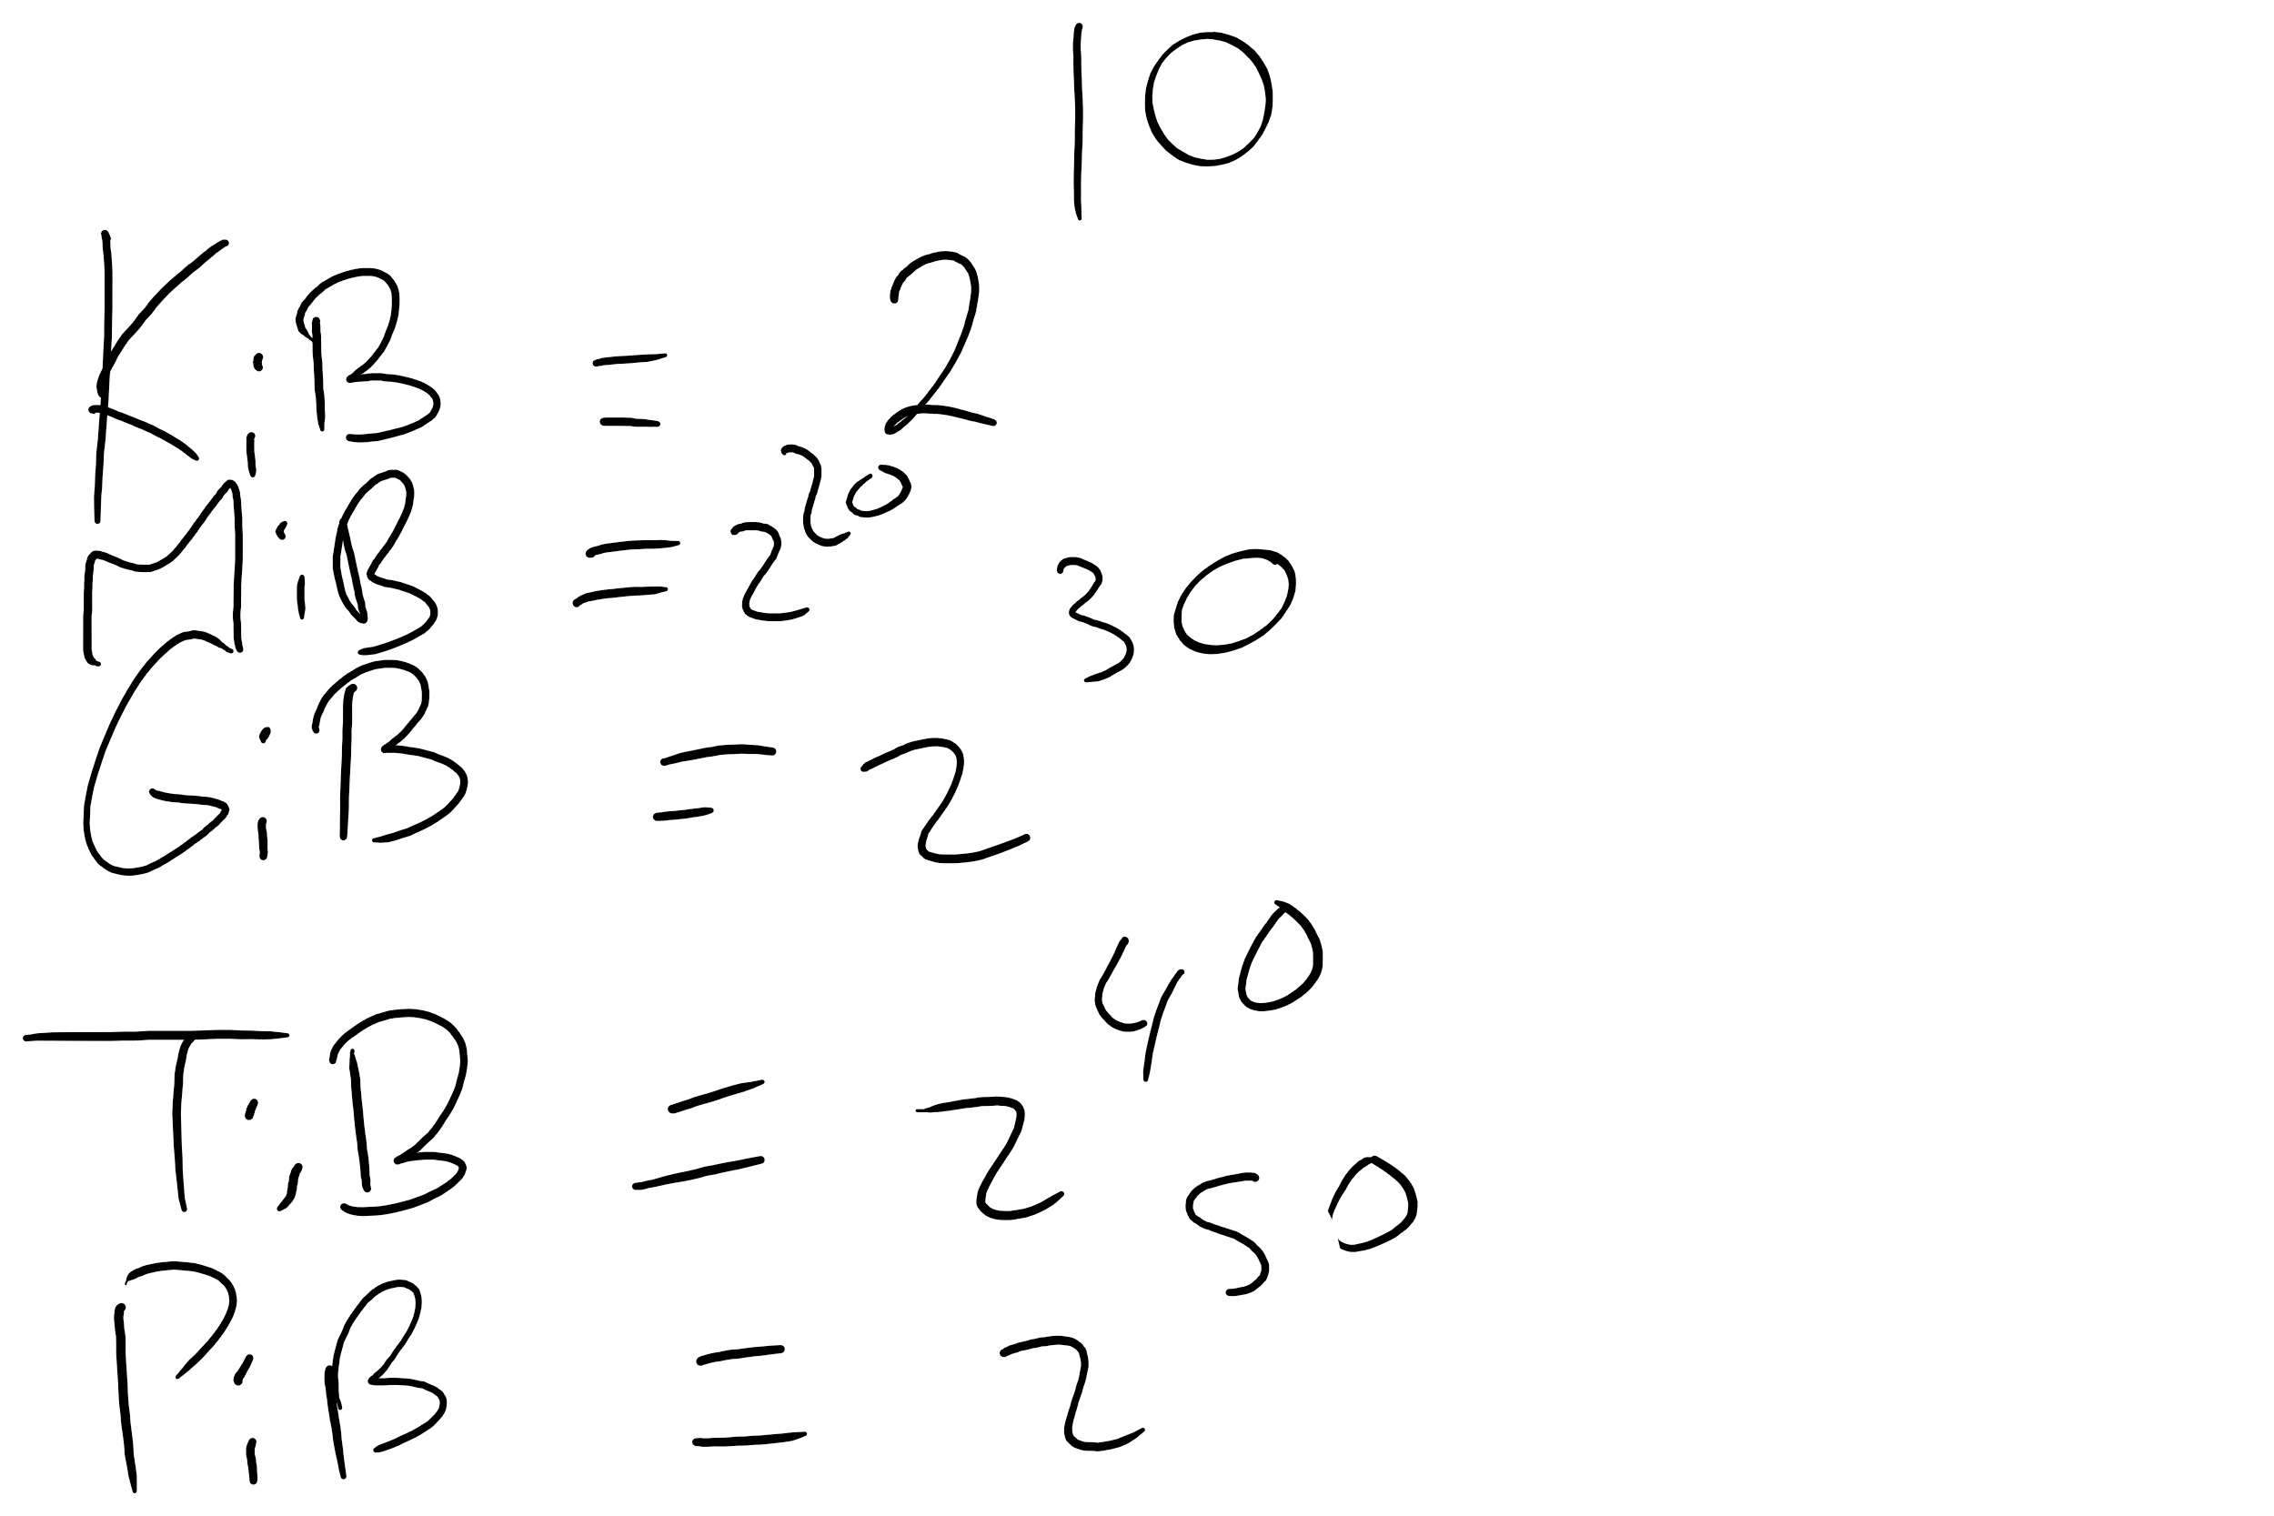
Memory Sizes

Slide 9
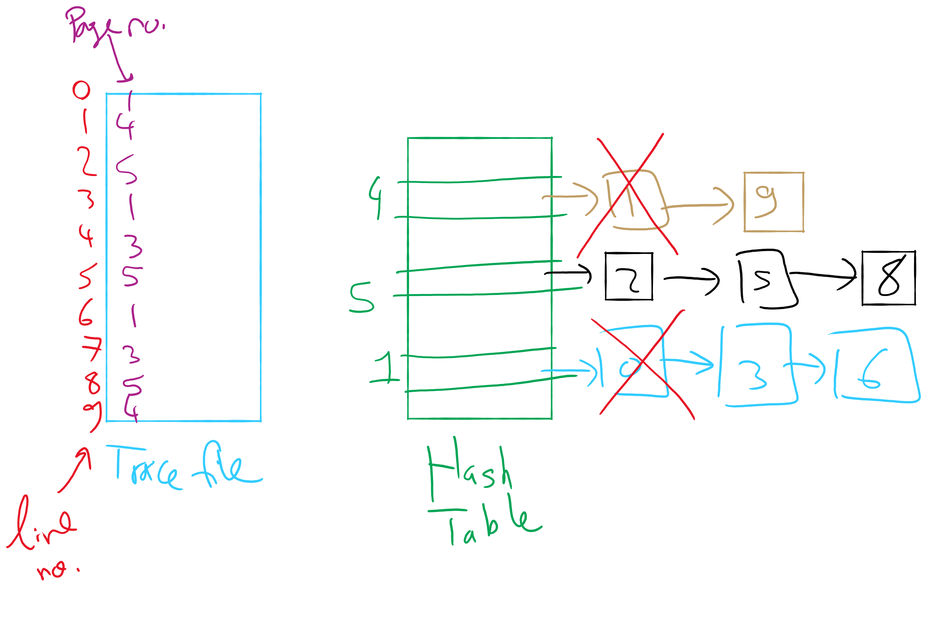
OPT Implementation Example

Slide 10
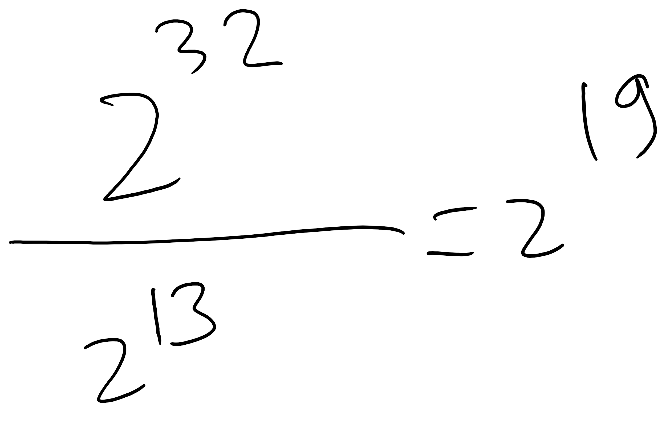
HW 8 Q 8

Slide 11
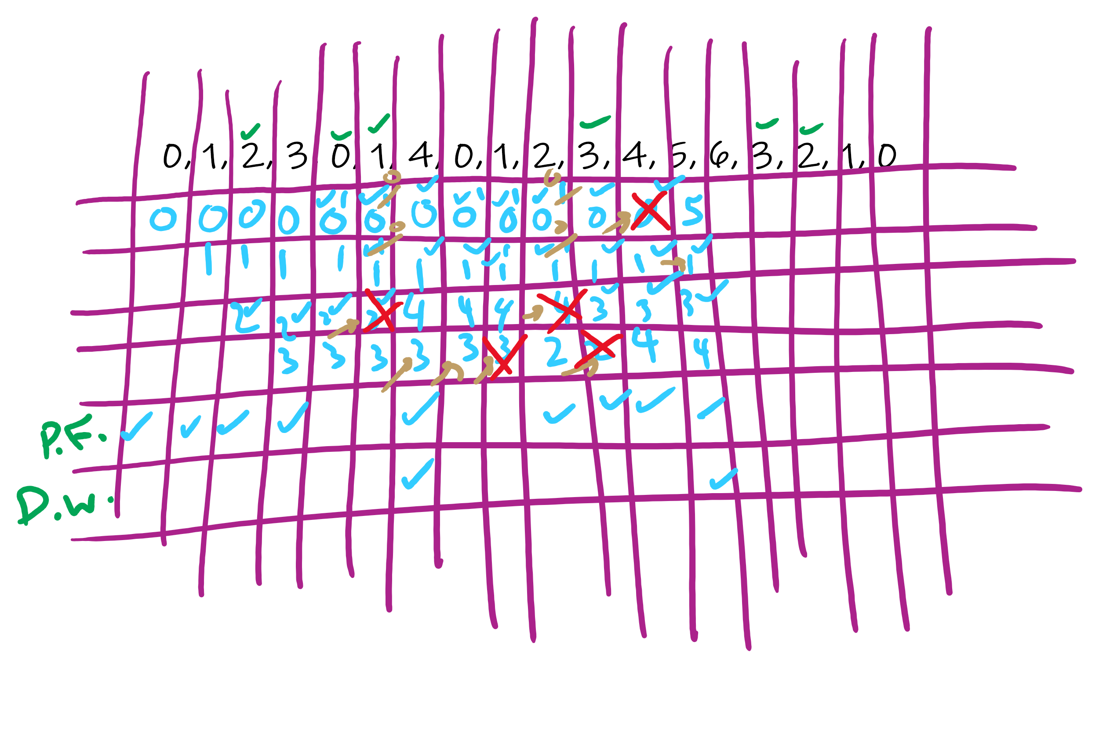
HW 9 Q 3

Slide 12
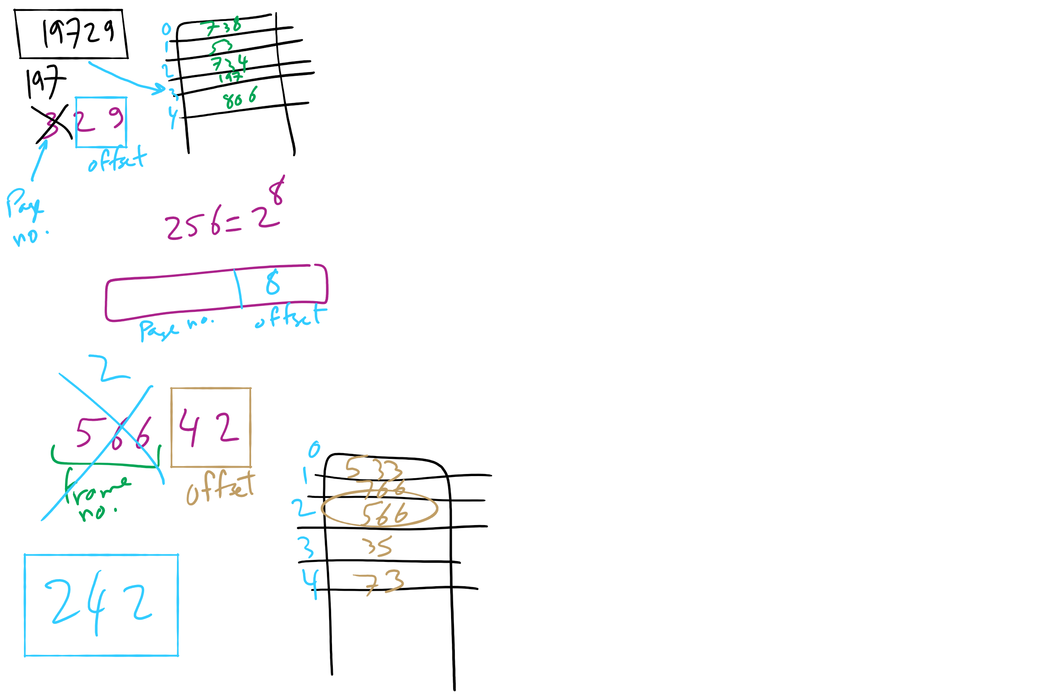
HW 9 Q 10-11

Slide 13
Today’s Agenda …
Inverted Page Table
Memory Management Issues

Slide 14
How long do memory accesses take?
Assume the following times:
TLB lookup time = a (often zero - overlapped in CPU)
Memory access time = m
Hit ratio (h) is percentage of time that a logical page number is found in the TLB
Larger TLB usually means higher h
TLB structure can affect h as well
Effective access time (an average) is calculated as:
EAT = (m + a)h + (m + m + a)(1-h)
EAT =a + (2-h)m
Interpretation
Reference always requires TLB lookup, 1 memory access
TLB misses also require an additional memory reference

Slide 15
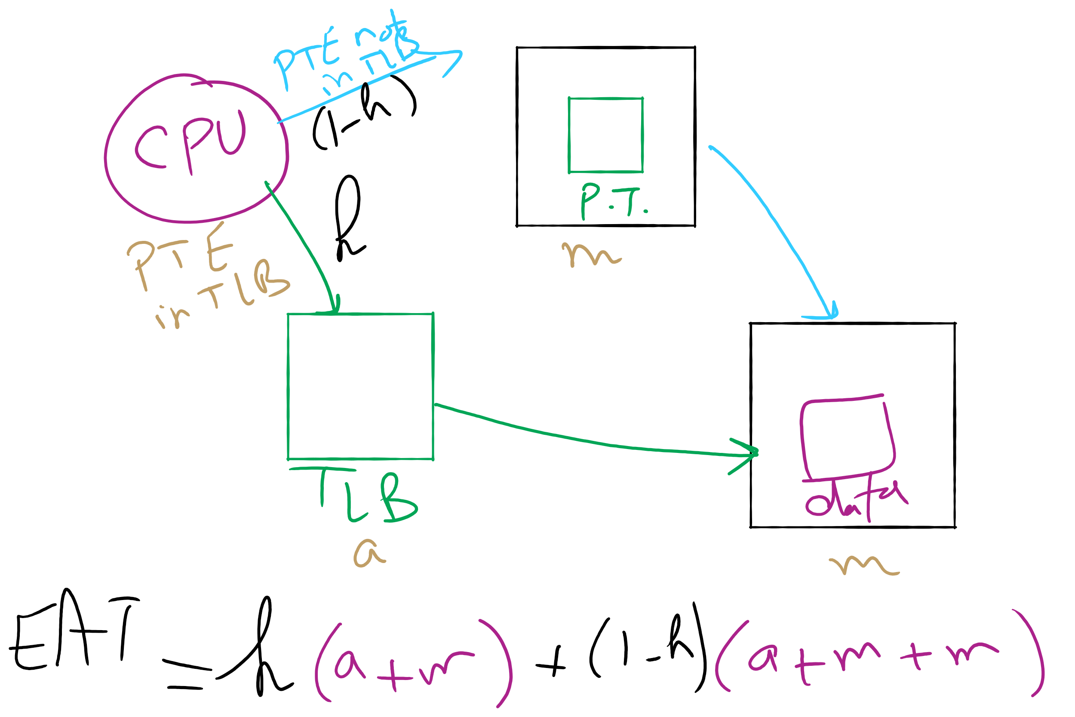
Effective Access Time

Slide 16
Inverted page table
Reduce page table size further: keep one entry for each frame in memory
PTE contains
Virtual address pointing to this frame
Information about the process that owns this page
Search page table by
Hashing the virtual page number and process ID
Starting at the entry corresponding to the hash result
Search until either the entry is found or a limit is reached
Page frame number is index of PTE
Improve performance by using more advanced hashing algorithms

Slide 17
Inverted page table architecture
page number
page offset
process ID
p = 19 bits
offset = 13 bits
Page frame number
0
pid
p
physical address
1
19
13
. . .
search
0
pid₀
p₀
1
pid₁
p₁
. . .
. . .
k
k
pid_{k}
p_{k}
main memory
. . .
inverted page table

Slide 18
Local vs. global allocation policies
What is the pool of pages eligible to be replaced?
Pages belonging to the process needing a new page
All pages in the system
Local allocation: replace a page from this process
May be more “fair”: penalize processes that replace many pages
Can lead to poor performance: some processes need more pages than others
Global allocation: replace a page from any process
Last access time
Page
A0
14
A1
12
Local allocation
A2
8
A3
A4
5
A4
B0
10
B1
9
Global allocation
B2
A4
3
C0
16
C1
12
C2
8
C3
5
C4
4

Slide 19
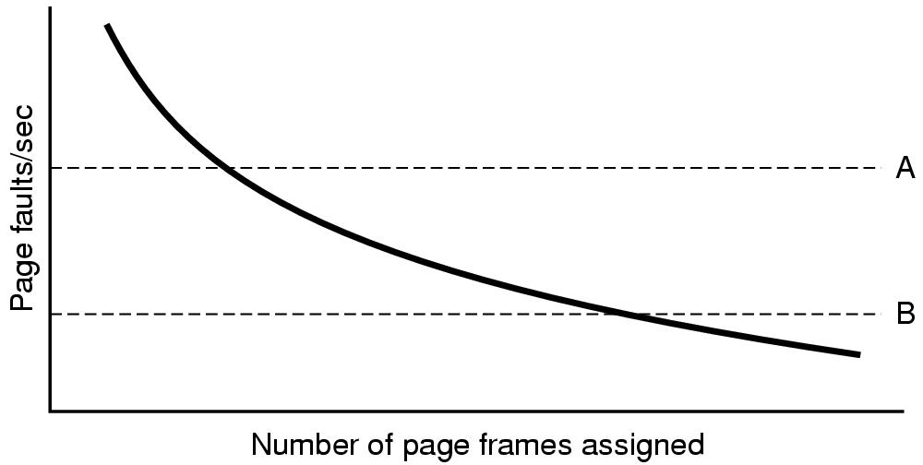
Page fault rate vs. allocated frames
Local allocation may be more “fair”
Don’t penalize other processes for high page fault rate
Global allocation is better for overall system performance
Take page frames from processes that don’t need them as much
Reduce the overall page fault rate (even though rate for a single process may go up)

Slide 20
Control overall page fault rate
Despite good designs, system may still thrash
Most (or all) processes have high page fault rate
Some processes need more memory, …
but no processes need less memory (and could give some up)
Problem: no way to reduce page fault rate
Solution : Reduce number of processes competing for memory
Swap one or more to disk, divide up pages they held
Reconsider degree of multiprogramming

Slide 21
How big should a page be?
Smaller pages have advantages
Less internal fragmentation
Better fit for various data structures, code sections
Less unused physical memory (some pages have 20 useful bytes and the rest isn’t needed currently)
Larger pages are better because
Less overhead to keep track of them
Smaller page tables
TLB can point to more memory (same number of pages, but more memory per page)
Faster paging algorithms (fewer table entries to look through)
More efficient to transfer larger pages to and from disk

Slide 22
Separate I & D address spaces
One user address space for both data & code
Simpler
Code/data separation harder to enforce
More address space?
One address space for data, another for code
Code & data separated
More complex in hardware
Less flexible
CPU must handle instructions & data differently
Instructions
Data
2³²-1
Data
Data
Code
Code
0

Slide 23
Sharing pages
Processes can share pages
Entries in page tables point to the same physical page frame
Easier to do with code: no problems with modification
Virtual addresses in different processes can be…
The same: easier to exchange pointers, keep data structures consistent
Different: may be easier to actually implement
Not a problem if there are only a few shared regions
Can be very difficult if many processes share regions with each other

Slide 24
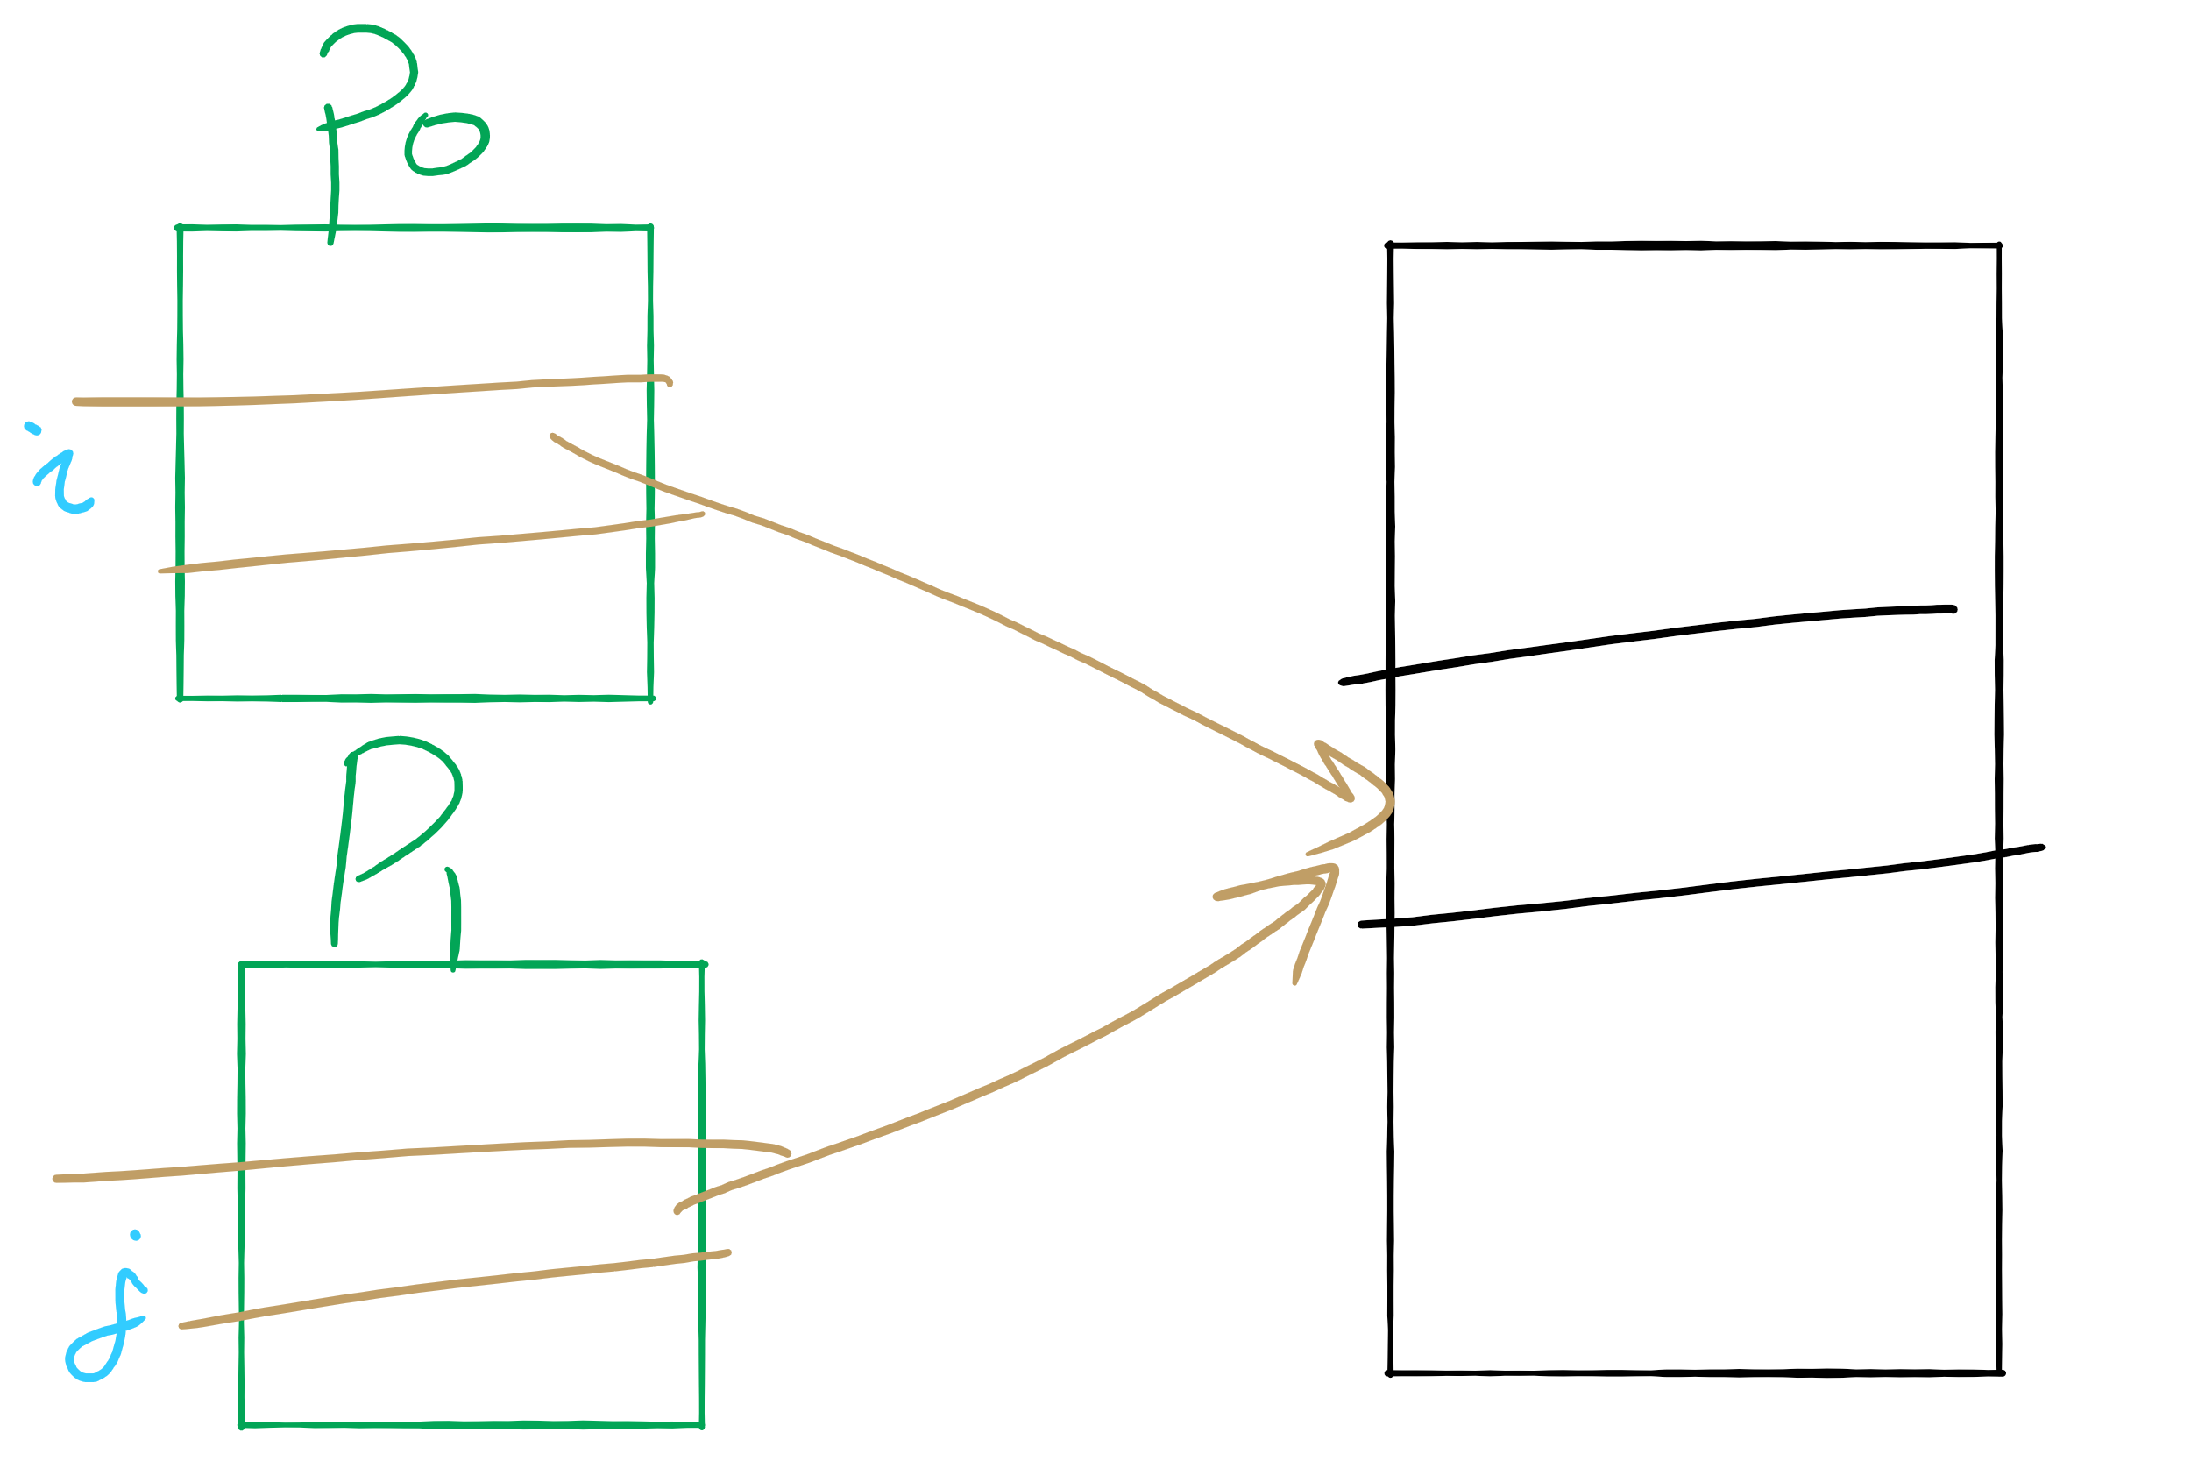
Sharing Pages

Slide 25
Implementation issues
Four times when OS involved with paging
Process creation
Determine program size
Create page table
During process execution
Reset the MMU for new process
Flush the TLB (or reload it from saved state)
Page fault time
Determine virtual address causing fault
Swap target page out, needed page in
Process termination time
Release page table
Return pages to the free pool

Slide 26
How is a page fault handled?
Hardware causes a page fault
General registers saved (as on every exception)
OS determines which virtual page needed
Actual fault address in a special register
Address of faulting instruction in register
Page fault was in fetching instruction, or
Page fault was in fetching operands for instruction
OS must figure out which…
OS checks validity of address
Process killed if address was illegal
OS finds a place to put new page frame
If frame selected for replacement is dirty, write it out to disk
OS requests the new page from disk
Page tables updated
Faulting instruction backed up so it can be restarted
Faulting process scheduled
Registers restored
Program continues

Slide 27
Backing up an instruction
Problem: page fault happens in the middle of instruction execution
Some changes may have already happened
Others may be waiting for VM to be fixed
Solution: undo all of the changes made by the instruction
Restart instruction from the beginning
This is easier on some architectures than others
Example: LW R1, 12(R2)
Page fault in fetching instruction: nothing to undo
Page fault in getting value at 12(R2): restart instruction
Example: ADD (Rd)+,(Rs1)+,(Rs2)+
Page fault in writing to (Rd): may have to undo an awful lot…

Slide 28
Locking pages in memory
Virtual memory and I/O occasionally interact
P1 issues call for read from device into buffer
While it’s waiting for I/O, P2 runs
P2 has a page fault
P1’s I/O buffer might be chosen to be paged out
This can create a problem because an I/O device is going to write to the buffer on P1’s behalf
Solution: allow some pages to be locked into memory
Locked pages are immune from being replaced
Pages only stay locked for (relatively) short periods

